Slide 1
HEART FAILURE CLASSIFICATION
Project Presentation

Slide 2
Purpose of the Project
Heart failure is a critical health condition that requires medical care and intervention. Early detection and effective management of the disease is vital for patient outcomes. Therefore, it is important to evaluate the accuracy of heart failure prediction with the use of machine learning algorithms, understanding the ability of these algorithms to utilize patient data based on clinical and demographic characteristics.
This presentation addresses heart failure prediction using various machine learning classification algorithms. The dataset used for analysis includes clinical characteristics of 299 patients. The algorithms examined include Logistic Regression, K Nearest Neighbor (KNN), Support Vector Classifier (SVC), Gaussian Naive Bayes, Decision Tree Classifier and Random Forest Classifier.
names of used Algorithms: Logistic | KNN | SVC | GNB | DTC | RFC

Slide 3
Exploratory Data Analysis
In this section, I will take a first look at the data set. First, I will look at the first few rows and columns in the data set to get some preliminary information about the overall data structure. Then, I will take a detailed look at the data types and possible missing data by checking the types of variables. Distribution analysis involves a step where I visually examine the distributions of variables and analyze them with techniques such as histograms and density plots. I determined the general trends of the variables in the dataset by calculating basic statistical measures such as measures of central tendency and dispersion, mean, median, mode, etc. I also created a correlation matrix to understand the relationships between variables and according to this correlation matrix, I removed some uncorrelated variables from my dataset to not be used in model training. Thus, I tried to optimize model performance by identifying the most appropriate features for machine learning models.
name of used Scaler and Analysis: StandardScaler | RFECV | Correlation

Slide 4
Descriptive Statistics
In this section, I will take a first look at the dataset. First, let's look at the first 10 variables in the dataset. We can get preliminary information about the overall data structure.

Slide 5
Now it is time to check the types of variables and make a detailed examination of the data types and possible missing data.
Looking at the two graphs above, we can see the number of rows and columns in the dataset, the types of data and that none of these variables have missing values. This is very good for model.

Slide 6
I will also use the table below to learn about the general distributions and measures of central tendency of numerical variables.

Slide 7
The table above presents statistical information on the number of data points in each column, the mean and standard deviation of the values in the column, minimum and maximum values, first quartile, median and third quartile values.
For example, according to the data obtained for the "age" column, the mean age of the patients is 60.83 and the standard deviation of the age values is 11.89. This shows that age data is generally distributed around this mean and the standard deviation shows how much age values can vary. Similarly, similar statistical information was provided for the other.
From this information we can learn about the dataset, in particular about measures of central tendency and dispersion.

Slide 8
In addition, by visualizing the relationships between each variable in the dataset, we can also learn about central tendency and dispersion.

Slide 9
Each variable contributes differently to the model, some may affect the performance of the model well, while others may affect it poorly. I will use the following metrics to evaluate them.
I also created a correlation matrix to understand the relationships between the variables, and based on this correlation matrix, I removed some uncorrelated variables from my dataset to not be used in model training.

Slide 10
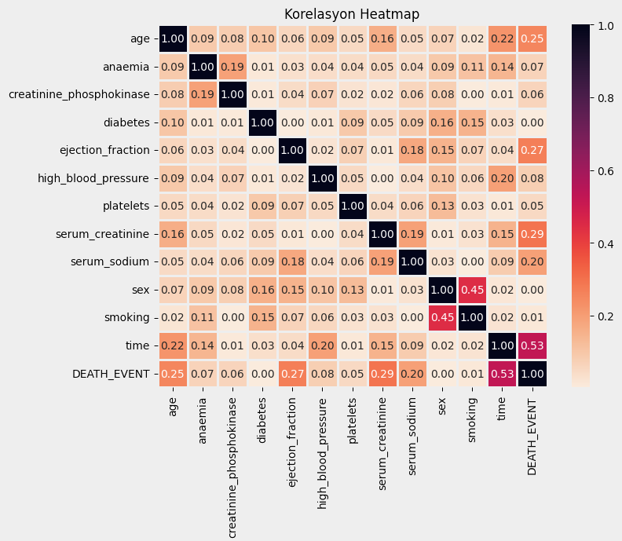

Slide 11
Below you can see the correlation values of all independent variables ordered from largest to smallest relative to the dependent variable. These relationships can also be negative. In this section, I will show the ranking in this order as I take the absolute value of all relationships.
And as a result, the 5 independent variables with the highest association values were selected from the graph on the left.
Of course, I still trained the model using all variables, but I got better performance when I eliminated them.

Slide 12
Recursive Feature Elimination Cross Validation (RFECV)
Recursive Feature Elimination Cross Validation (RFECV) is a feature selection technique used in machine learning to identify and select the most relevant features for a predictive model. It works by recursively removing the least important features from the dataset until the desired number of features is reached.
Although I included this method in my project code, the variable selection I did manually gave better results. For this reason, I did not use RFE in this project. In addition to RFE, there are also various libraries such as Model Selection and Sequential Feature Selection.
Below you can see that the RFE model for Logistic Regression indicates that it will perform better when it selects 9 out of 12 independent variables. The selected variables are: 'age', 'anaemia', 'diabetes', 'ejection_fraction', 'high_blood_pressure', 'serum_creatinine', 'sex', 'smoking', 'time'.

Slide 13
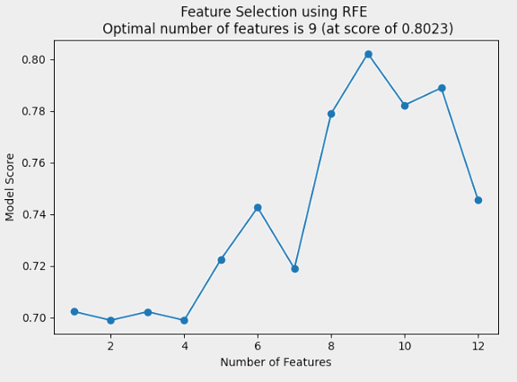
Recursive Feature Elimination Cross Validation (RFECV)

Slide 14
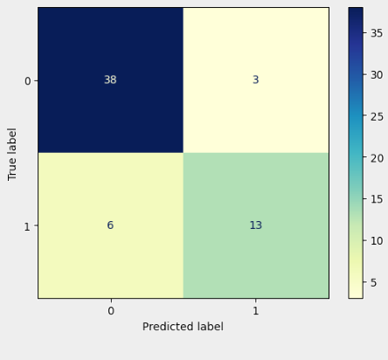
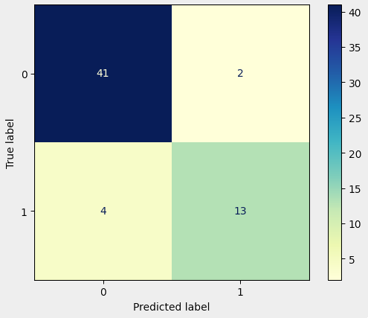
Recursive Feature Elimination Cross Validation (RFECV)
When the model is trained with these 9 variables, the accuracy is 0.85, while the accuracy of the 5 variables I manually selected is 0.9. In the confusion matrices below, the left one is the variables suggested by RFECV and the right one is my manual selection. (Logistic Regression)

Slide 15
Model Building, Evaluation and Performance Metrics
The machine learning model construction and evaluation phase involves applying various classification algorithms on the dataset. The six main classifiers used in this step are: Logistic Regression, K Nearest Neighbor (KNN), Support Vector Classifier (SVC), Gaussian Naive Bayes, Decision Tree Classifier and Random Forest Classifier. And the performances of these classifiers are presented below.

Slide 16
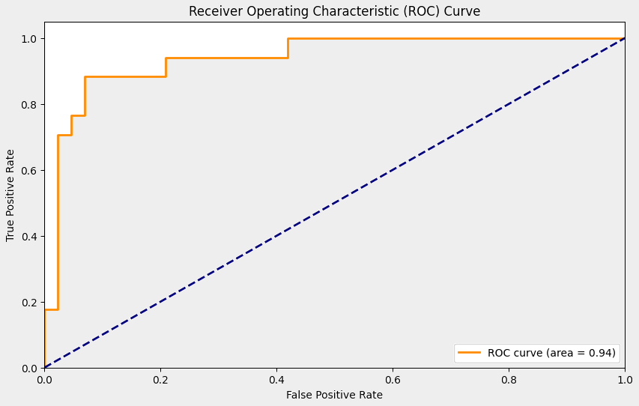
Logistic Regression
Logistic Regression is a statistical model used to estimate the probability of a dependent variable. In this project, the Logistic Regression model was successful in predicting heart failure with 90% accuracy, 86% ROC AUC Score and 94% overall AUC.

Slide 17
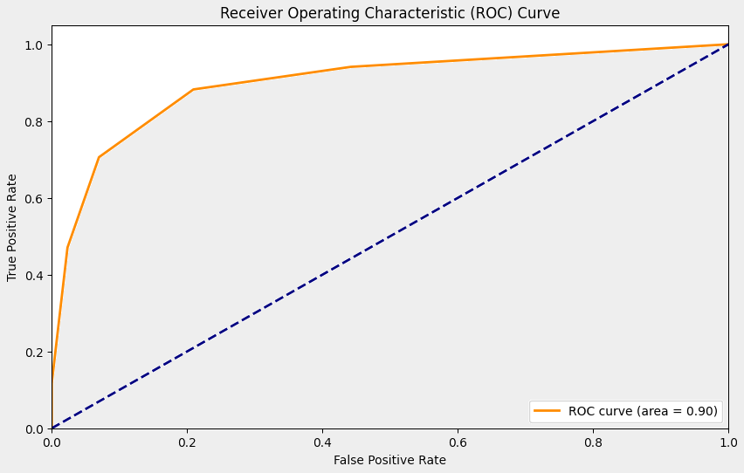
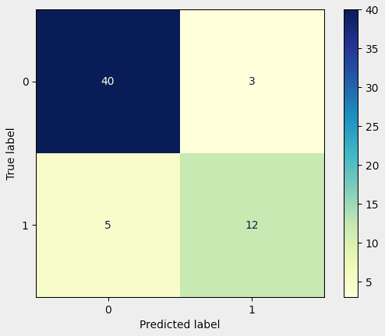
K-Nearest Neighbors (KNN)
K Nearest Neighbor uses the classes of the k closest data points in its neighborhood to determine the class of a data point. This model was evaluated with 86.67% accuracy rate, 81.81% ROC AUC Score and 90% overall AUC.

Slide 18

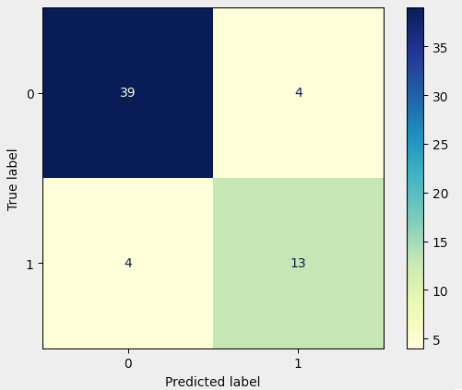
Support Vector Classifier (SVC)
The Support Vector Classifier attempts to classify data points by drawing a decision boundary between classes. This model was evaluated with 86.67% accuracy, 83.58% ROC AUC Score and 92% overall AUC.

Slide 19

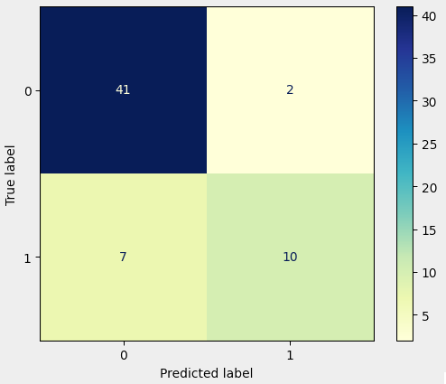
Gaussian Naive Bayes
Gaussian Naive Bayes classifies using Bayes theorem and feature independence assumption. This model was evaluated with 85% accuracy, 77.09% ROC AUC Score and 90% overall AUC.

Slide 20
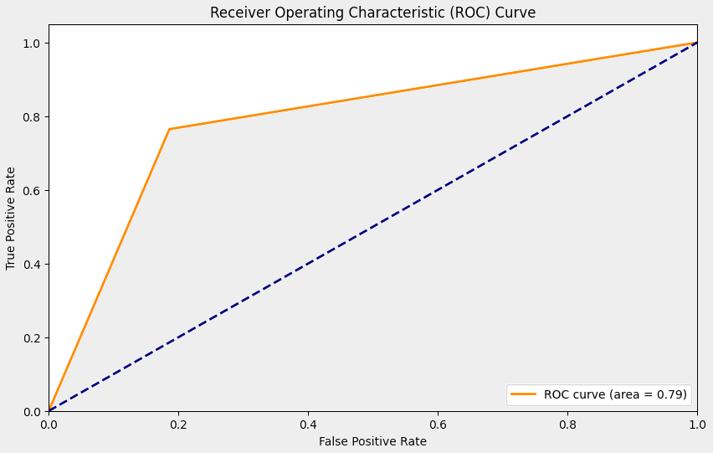
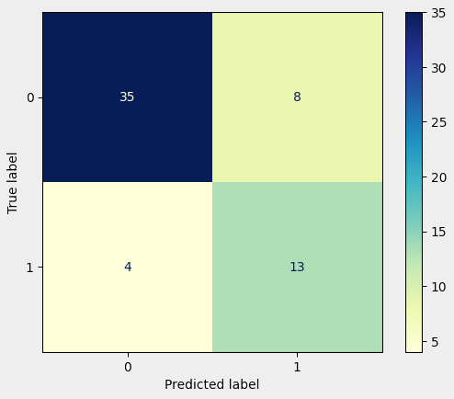
Decision Tree Classifier
Decision Tree classifies by partitioning the dataset with a set of decision rules. The model was evaluated with 80% accuracy, 78.93% ROC AUC Score and 79% overall AUC.

Slide 21
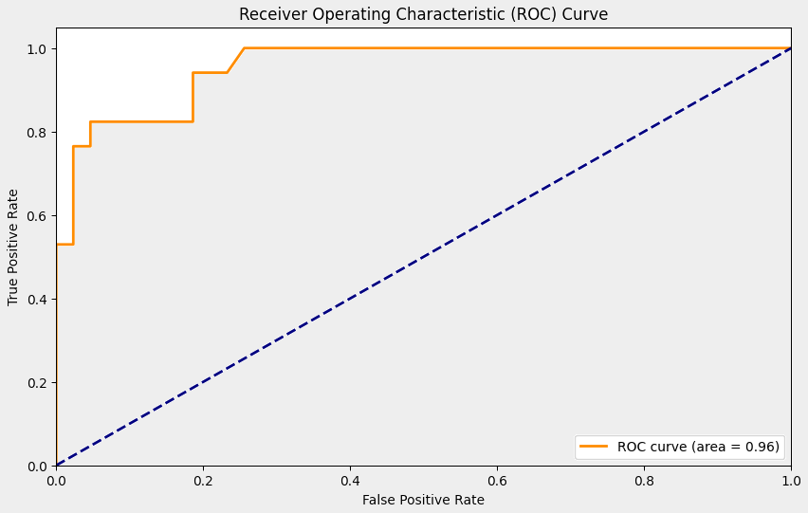
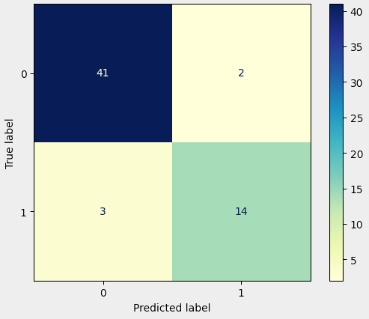
Random Forest Classifier – BEST MODEL
Random Forest creates a more powerful model by training multiple decision trees and combining their predictions. This model was evaluated with 91.67% accuracy, 88.85% ROC AUC Score and 96% overall AUC.

Slide 22
Comparison of Algorithms and Results
The results show that machine learning algorithms can effectively predict heart failure based on clinical features. Logistic Regression and Random Forest Classifier outperform other algorithms in terms of accuracy and AUC. Nevertheless, the Random Forest Classifier is the best.

Slide 23

Thanks!
For Listening !
Fatih Emre Ertekin
Project Presentation

